Slide 1
Software Testing

Slide 2
A Definition…
Testing is the process of executing a program with the intent of finding errors.
- Glen Myers

Slide 3
Which definition of SW Testing is most appropriate ?
a) Testing is the process of demonstrating that errors are not present.
b) Testing is the process of demonstrating that a program performs its intended functions.
c) Testing is the process of removing errors from a program and fixing them.
None of the above definitions set the right goal for effective SW Testing

Slide 4
What is Software Testing ?
Testing is a verification (static) and validation (dynamic) activity that is performed by reviewing or executing program code.

Slide 5
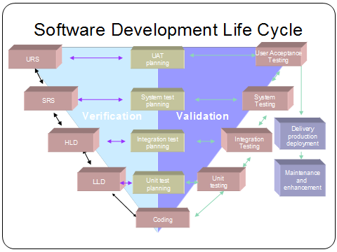

Slide 6
Static Testing | Dynamic Testing
Testing done without executing the program | Testing done by executing the program
This testing does verification process | Dynamic testing does validation process
Static testing gives assessment of code and documentation | Dynamic testing gives bugs/bottlenecks in the software system.
Static testing involves checklist and process to be followed | Dynamic testing involves test cases for execution
This testing can be performed before compilation | Dynamic testing is performed after compilation
Static testing covers the structural and statement coverage testing | Dynamic testing covers the executable file of the code
Cost of finding defects and fixing is less | Cost of finding and fixing defects is high
Return on investment will be high as this process involved at early stage | Return on investment will be low as this process involves after the development phase

Slide 7
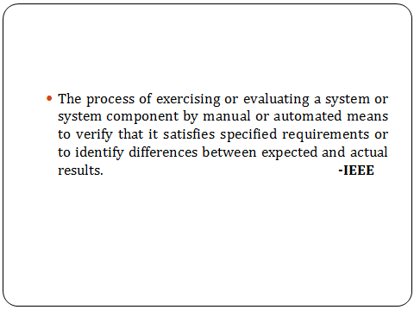
A Good Definition

Slide 8
Objectives of SW Testing
The main objective of SW testing is to find errors.
Indirectly testing provides assurance that the SW meets its requirements.
Testing helps in assessing the quality and reliability of software.

Slide 9
Testing v/s Debugging
Debugging is not Testing
Debugging always occurs as a consequence of testing
Testing attempts to find the error (cause of an error) and Debugging is to correct it.

Slide 10
Psychology of Testing
Testing is a destructive process -- show that a program does not work by finding errors in it.
Start testing with the assumption that -
the program contains errors.
A successful test case is one that finds an error.
It is difficult for a programmer to test his/her own program effectively with the proper frame of mind required for testing.

Slide 11
Basic Testing Strategies
Black-box testing
White-box testing

Slide 12
Black-Box Testing
Tests that validate business requirements -- (what the system is supposed to do)
Test cases are derived from the requirements specification of the software. No knowledge of internal program structure (code) is used.
Also known as -- functional, data-driven, or Input/Output testing

Slide 13
White-Box Testing
Tests that validate internal program logic (control flow, data structures, data flow etc.)
Test cases are derived by examination of the internal structure (code) of the program.
Also known as -- structural or logic-driven testing

Slide 14
Black-box vs White-Box Testing
Black box testing can detect errors such as
  incorrect functions, missing functions
  It cannot detect design errors, coding errors, unreachable code, hidden functions
White box testing can detect errors such as
  logic errors, design errors
  It cannot detect whether the program is performing its expected
  functions, missing functionality.
Both methods of testing are required.

Slide 15
Black-box v/s White-box Testing
Black-box Testing
White-box testing
Tests function
Tests structure
Can find requirements
specification errors
Can find design and
coding errors
Can find missing
functions
Can’t find missing
functions

Slide 16
Is Complete Testing Possible ?
Can Testing prove that a program is
completely free of errors ?
--- No
Complete testing in the sense of a proof is not theoretically possible, and certainly not practically possible.

Slide 17
Example
Test a function that adds two 32-bit numbers and returns the result.
  Assume we can execute 1000 test cases per sec
How long will it take to thoroughly test this function?
2^64 combinations in all (to test this program THOROUGHLY)

Slide 18
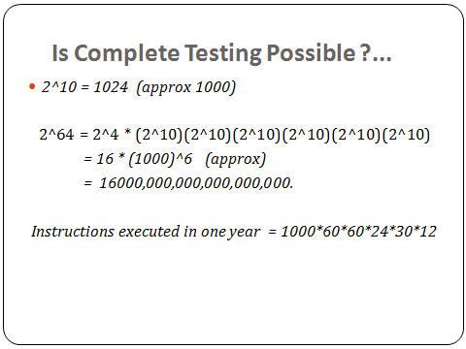

Slide 19
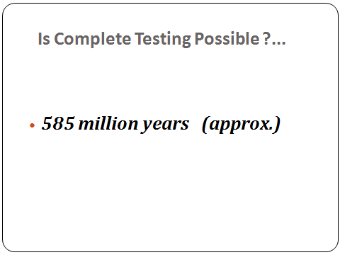

Slide 20
Is Complete Testing Possible ?
Exhaustive Black-box testing is generally not possible because the input domain for a program may be infinite or incredibly large.
Exhaustive White-box testing is generally not possible because a program usually has a very large number of paths.

Slide 21
Implications ...
Test-case design
  careful selection of a subset of all possible test cases
  The objective should be to maximize the number of errors found by a small finite number of test cases.

Slide 22
Test cases and Test suites
Test case is a triplet [I, S, O] where
  I - is input data
  S - is state of system at which data will be input
  O - is the expected output
Test suite is set of all test cases
Test cases are not randomly selected. Instead, they need to be designed.

Slide 23
Black-Box Testing
Program viewed as a Black-box, which accepts some inputs and produces some outputs
Test cases are derived solely from the specifications, without knowledge of the internal structure of the program.

Slide 24
Functional Test-Case Design Techniques
Equivalence class partitioning
Boundary value analysis
Cause-effect graphing
Error guessing

Slide 25
Equivalence Class Partitioning
Partition the program input domain into equivalence classes (classes of data which according to the specifications are treated identically by the program)
The basis of this technique is that test of a representative value of each class is equivalent to a test of any other value of the same class.
identify valid as well as invalid equivalence classes
For each equivalence class, generate a test case to exercise an input representative of that class

Slide 26
Example
Example: input condition 0 <= x <= max
  valid equivalence class : 0 <= x <= max
  invalid equivalence classes : x < 0, x > max
3 test cases

Slide 27
Guidelines for Identifying Equivalence Classes
Input Condition Valid Eq Classes Invalid Eq Classes
range of values one valid two invalid
(eg. 1 - 200) (value within range) (one outside each
end of range)
number N valid one valid two invalid
values (none, more than N)
Set of input values one valid eq class one
each handled for each value (eg. any value not
differently by the in valid input set )
program (eg. A, B, C)

Slide 28
Guidelines for Identifying Equivalence Classes
Input Condition Valid Eq Classes Invalid Eq Classes
must be condition one one
(eg. Id name must (eg. it is a letter) (eg. it is not a letter)
begin with a letter )
If you know that elements in an equivalence class are not handled identically by the program, split the equivalence class into smaller equivalence classes.

Slide 29
Identifying Test Cases for Equivalence Classes
Assign a unique number to each equivalence class
Until all valid equivalence classes have been covered by test cases, write a new test case covering as many of the uncovered valid equivalence classes as possible.
Each invalid equivalence class cover by a separate test case.
Test Cases for--
Triangle problem- equilateral, scalene, Isosceles.
Railway ticket booking- Child( <12 yrs), Senior citizen or normal ticket.

Slide 30
Boundary Value Analysis
Design test cases that exercise values that lie at the boundaries of an input equivalence class and for situations just beyond the ends.
Also identify output equivalence classes, and write test cases to generate o/p at the boundaries of the output equivalence classes, and just beyond the ends.
Example: input condition 0 <= x <= max
Test for values : 0, max ( valid inputs)
: -1, max+1 (invalid inputs)

Slide 31
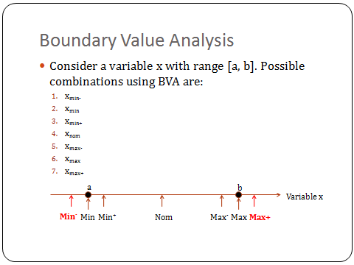

Slide 32
Cause Effect Graphing
A technique that aids in selecting test cases for combinations of input conditions in a systematic way.

Slide 33
Cause Effect Graphing Technique
Identify the causes (input conditions) and effects (output conditions) of the program under test.
For each effect, identify the causes that can produce that effect. Draw a Cause-Effect Graph.
Create Decision Table.
4. Generate a test case for each combination of input conditions that make some effect to be true.

Slide 34
Testing based on Decision Tables
A matrix (tabular) representation of the logic of a decision
Specifies the possible conditions and the resulting actions
Generate a test case for each combination of input conditions i.e. for each column of decision table, that make some effect to be true.

Slide 35
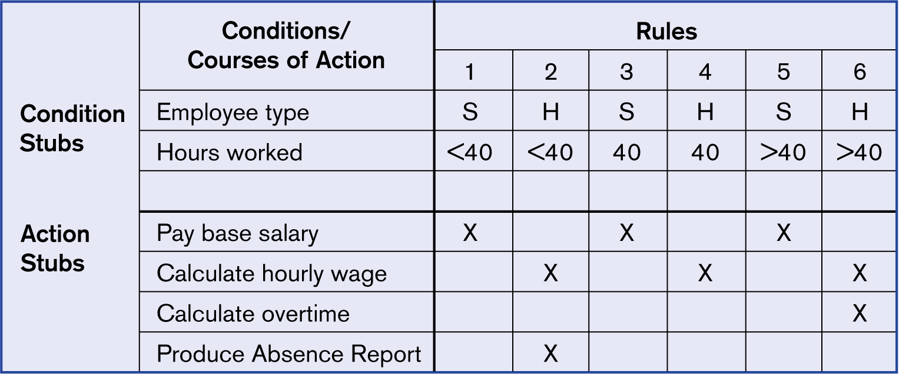
Example decision table for payroll system example
S- regular Serving employee, H- Hired employee on contract

Slide 36
Example
Consider a program with the following:
input conditions Output conditions
c1: command is credit e1: print invalid command
c2: command is debit e2: print invalid A/C
c3: A/C is valid e3: print debit amount not valid
c4: Transaction amount not e4: debit A/C
valid e5: credit A/C

Slide 37
Example: Cause-Effect Graph
or
E1
not
C1
and
E2
not
C2
and
and
E3
not
C3
and
E5
and
not
C4
and
and
E4

Slide 38
Example: Cause-Effect Graph
or
E1
not
C1
and
E2
not
C2
and
and
E3
not
C3
and
E5
and
not
C4
and
and
E4

Slide 39
Example
Decision table showing the combinations of input conditions that make an effect true. (summarized from Cause Effect Graph)
Write test cases to exercise each Rule in decision Table.
Example:
C1
C2
C3
C4
0
0
-
-
1
-
0
-
-
1
1
0
-
1
1
1
1
-
1
1
E1
E2
E3
E4
E5
1
1
1
1
1

Slide 40
Error Guessing
From perception and experience, enumerate a list of possible errors or error prone situations and then write test cases to expose those errors.

Slide 41
White Box Testing
White box testing is concerned with the degree to which test cases exercise or cover the logic (source code) of the program.
White box Test case design techniques
Statement coverage Basis Path Testing
Decision coverage Loop testing
Condition coverage
Decision-condition coverage Data flow testing
Multiple condition coverage

Slide 42
White Box Test-Case Design
Statement coverage
  write enough test cases to execute every statement at least once (in order to examine every
  statement of the code)
  TER (Test Effectiveness Ratio) or Coverage Analysis
  TER1 = statements exercised / total statements

Slide 43
Example
void function eval (int A, int B, int X )
{
if ( A > 1) and ( B = 0 )
then X = X / A;
if ( A = 2 ) or ( X > 1)
then X = X + 1;
}
Statement coverage test cases:
1) A = 2, B = 0, X = 3 ( X can be assigned any value)

Slide 44
White Box Test-Case Design
Decision coverage (branch coverage)
  write test cases to exercise the true and false outcomes of every decision
  TER2 = branches exercised / total branches
Condition coverage
  write test cases such that each condition in a decision takes on all possible outcomes at least once

Slide 45
Condition coverage
In this structural testing, test cases are designed to make each component of a composite conditional expression to assume both true and false values.
For example, in the conditional expression ((c1.and.c2).or.c3), the components c1, c2 and c3 are each made to assume both true and false values

Slide 46
Decision coverage Example
a
void function eval (int A, int B, int X )
{
if ( A > 1) and ( B = 0 ) then
X = X / A;
if ( A = 2 ) or ( X > 1) then
X = X + 1;
}
Decision coverage test cases:
A > 1
and
B = 0
T
c
F
b
X = X/ A
A = 2
or
X > 1
T
e
F
1) A = 3, B = 0, X = 3 (acd)
d
X = X+1
2) A = 2, B = 1, X = 1 (abe)

Slide 47
Example
Condition coverage test cases must cover conditions
A>1, A<=1, B=0, B !=0
A=2, A !=2, X >1, X<=1
Test cases:
1) A = 1, B = 0, X = 3 (abe)
2) A = 2, B = 1, X = 1 (abe)
does not satisfy decision coverage
a
A > 1
and
B = 0
T
c
F
b
X = X/ A
A = 2
or
X > 1
T
e
Y
d
X = X+1

Slide 48
White Box Test-Case Design
Decision Condition coverage
  write test cases such that each condition in a decision takes on all possible outcomes at least once and each decision takes on all possible outcomes at least once
Multiple Condition coverage
  write test cases to exercise all possible combinations of True and False outcomes of conditions within a decision

Slide 49
Example
Decision Condition coverage test cases must cover conditions
A>1, A<=1, B=0, B !=0
A=2, A !=2, X >1, X<=1
also ( A > 1 and B = 0) T, F
( A = 2 or X > 1) T, F
Test cases:
1) A = 2, B = 0, X = 4 (ace)
2) A = 1, B = 1, X = 1 (abd)
a
A > 1
and
B = 0
T
c
F
b
X = X/ A
A = 2
or
X > 1
T
e
Y
d
X = X+1

Slide 50
Example
Multiple Condition coverage must cover conditions
1) A >1, B =0 5) A=2, X>1
2) A >1, B !=0 6) A=2, X <=1
3) A<=1, B=0 7) A!=2, X > 1
4) A <=1, B!=0 8) A !=2, X<=1
Test cases:
1) A = 2, B = 0, X = 4 (covers 1,5)
2) A = 2, B = 1, X = 1 (covers 2,6)
3) A = 1, B = 0, X = 2 (covers 3,7)
4) A = 1, B = 1, X = 1 (covers 4,8)

Slide 51
Basis Path Testing
1. Draw control flow graph of program from the program detailed design or code.
2. Compute the Cyclomatic complexity V(G) of the flow graph using any of the formulas:
V(G) = #Edges - #Nodes + 2
or V(G) = #regions in flow graph
or V(G) = #predicates + 1

Slide 52
Example
1
V(G) = 6 regions
V(G) = #Edges - #Nodes
+ 2
= 17 - 13 + 2 = 6
V(G) = 5 predicate-nodes
+ 1 = 6
2
R4
3
R1
4
R6
5
10
6
R2
6 linearly
independent paths
11
R5
12
R3
8
7
13
9

Slide 53
A linearly independent path is any path through the program that introduces at least one new edge that is not included in any other linearly independent paths. If a path has one new node compared to all other linearly independent paths, then the path is also linearly independent. This is because, any path having a new node automatically implies that it has a new edge. Thus, a path that is subpath of another path is not considered to be a linearly independent path.

Slide 54
Basis Path Testing (contd)
3. Determine a basis set of linearly independent paths.
i—1-2-10-12-13;
ii-- 1-2-10-11-13; iii--1-2-3-10-12-13
iv– 1-2-3-4-5-8-9-1…; v– 1-2-3-4-5-6-8-9-1…;
vi—1-2-3-4-5-6-7-8-9-1…;
4. Prepare test cases that will force execution of each path in the Basis set.
The value of Cyclomatic complexity provides an upper bound on the number of tests that must be designed to guarantee coverage of all program statements.

Slide 55
Loop Testing
Aims to expose bugs in loops
Fundamental Loop Test criteria
  1) bypass the loop altogether
  2) one pass through the loop
  3) two passes through the loop before exiting
  4) A typical number of passes through the loop, unless covered by some other test

Slide 56
Loop Testing
Nested loops
  1) Set all but one loop to a typical value and run through the single-loop cases for that loop. Repeat for all loops.
  2) Do minimum values for all loops simultaneously.
  3) Set all loops but one to the minimum value and repeat the test cases for that loop. Repeat for all loops.
  4) Do maximum looping values for all loops simultaneously.

Slide 57
Data Flow Testing
Select test paths of a program based on the Definition-Use (DU) chain of variables in the program.
Write test cases to cover every DU chain at least once.

Slide 58
Data-flow testing uses the control flow graph and data flow graph to explore the unreasonable things that can happen to data (i.e., anomalies).
Consideration of data-flow anomalies leads
to test path selection strategies that fill the
gaps between complete path testing and
branch or statement testing.

Slide 59
Data flow testing…
(d) Defined, Created, Initialized
• (k) Killed, Undefined, Released
• (u) Used:
– (c) Used in a calculation
– (p) Used in a predicate

Slide 60
continue…
dd: Probably harmless, but suspicious.
• dk: Probably a bug.
• du: Normal situation.
• kd: Normal situation.
• kk: Harmless, but probably a bug.
• ku: Definitely a bug.
• ud: Normal situation (reassignment).
• uk: Normal situation.
• uu: Normal situation.

Slide 61
Testing Principles
--- Glen Myers
A good test case is one likely to show an error.
Description of expected output or result is an essential part of test-case definition.
A programmer should avoid attempting to test his/her own program.
  testing is more effective and successful if performed by an Independent Test Team.

Slide 62
Testing Principles (contd)
Avoid on-the-fly testing.
Document all test cases.
Test valid as well as invalid cases.
Thoroughly inspect all test results.
More detected errors implies even more errors may be present.

Slide 63
Testing Principles (contd)
Decide in advance when to stop testing
Do not plan testing effort under the implied assumption that no errors will be found.
Testing is an extremely creative and intellectually challenging task.

Slide 64
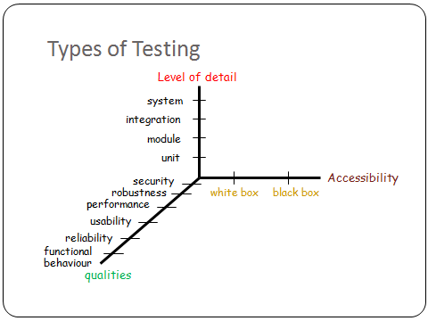
Software Testing - II

Slide 65
SOFTWARE TESTING LIFECYCLE - PHASES
        Requirements study for testing purpose
        Test Case Design and Development
        Test Execution
        Test Log and Closure
        Test Process Analysis

Slide 66
Testing Activities in the SW Life Cycle
User
Manual
Requirements
Specification
System Test,
AcceptanceTest
SRS
Tested
software
System Design
System
Integration Test
SRS
System
Design
Integrated
software
Detailed
Design
Integration Test
Module
designs
Tested
modules
Coding
Unit test
Code

Slide 67
Levels of Testing
Type of Testing
Performed By
Low-level testing
  Unit (module) testing
  integration testing
High-level testing
  Function testing
  System testing
  Acceptance testing
  Programmer
  Development team
  Independent Test Group
  Independent Test Group
  Customer

Slide 68
Unit Testing
  done on individual modules
  test module w.r.t module specification
  largely white-box oriented
  mostly done by programmer
  Unit testing of several modules can be done in parallel
  requires stubs and drivers

Slide 69
Unit testing
Objectives | To test the function of a program or unit of code such as a program or module To test internal logic To verify internal design To test path & conditions coverage To test exception conditions & error handling
When | After modules are coded
Input | Internal Application Design Master Test Plan Unit Test Plan
Output | Unit Test Report

Slide 70
following are needed in order to be able to test the module:
The procedures belonging to other modules that the module under test calls (stubs).
• Non-local data structures that the module accesses.
• A procedure to call the functions of the module under test with appropriate parameters (driver).

Slide 71
What are Stubs, Drivers ?
eg. module
call hierarchy
eg. to unit test B
in isolation
Stub
  dummy module which simulates the function of a module called by a given module under test
Driver
  a module which transmits test cases in the form of input arguments to the given module under test and either prints or interprets the results produced by it
A
Driver
B
B
C
Stub for C

Slide 72
Integration Testing
  tests a group of modules, or a subsystem
  test subsystem structure w.r.t design, subsystem functions
  focuses on module interfaces
  largely structure-dependent
  done by one/group of developers

Slide 73
Integration testing
Objectives | To technically verify proper interfacing between modules, and within sub-systems
When | After modules are unit tested
Input | Internal & External Application Design Master Test Plan Integration Test Plan
Output | Integration Test report

Slide 74
Integration Test Approaches
Non-incremental ( one step/ Big-Bang integration )
  unit test each module independently
  combine all the modules to form the system in one step, and test the combination
Incremental
  instead of testing each module in isolation, the next module to be tested is first combined with the set of modules that have already been tested
  testing approaches:- Top-down, Bottom-up

Slide 75
Example: Module Hierarchy
A
B
C
D
E
F
H

Slide 76
Comparison
Non-Incremental
requires more stubs,drivers
module interfacing errors detected late
debugging errors is difficult
Incremental
requires less stubs, drivers
module interfacing errors detected early
debugging errors is easier
results in more thorough testing of modules

Slide 77
Top-down Integration
Begin with the top module in the module call hierarchy
Stub modules are produced
  Stubs are often complicated
The next module to be tested is any module with atleast one previously tested superordinate (calling) module
After a module has been tested, one of its stubs is replaced by an actual module (the next one to be tested) and its required stubs

Slide 78
Example: Module Hierarchy
A
B
C
D
E
F
H

Slide 79
Top-down Integration Testing
Example:
A
Stub B
Stub C
Stub D

Slide 80
Top-down Integration Testing
Example:
A
B
Stub C
Stub D
Stub E
Stub F

Slide 81
Bottom-Up Integration
Begin with the terminal modules (those that do not call other modules) of the modules call hierarchy
A driver module is produced for every module
The next module to be tested is any module whose subordinate modules (the modules it calls) have all been tested
After a module has been tested, its driver is replaced by an actual module (the next one to be tested) and its driver

Slide 82
Example: Module Hierarchy
A
B
C
D
E
F
H

Slide 83
Bottom-Up Integration Testing
Example:
Driver B
Driver B
E
F

Slide 84
Bottom-Up Integration Testing
Example:
Driver A
B
E
F

Slide 85
Comparison
Top-down Integration
Advantage
  a skeletal version of the program can exist early
Disadvantage
  required stubs could be expensive
Bottom-up Integration
Disadvantage
  the program as a whole does not exist until the last module is added
No clear winner
Effective alternative -- use Hybrid of bottom-up and top-down
- prioritize the integration of modules based on risk
- highest risk functions are integration tested earlier
than modules with low risk functions

Slide 86
Levels of Testing
Type of Testing
Performed By
Low-level testing
  Unit (module) testing
  integration testing
High-level testing
  Function testing
  System testing
  Acceptance testing
  Programmer
  Development team
  Independent Test Group
  Independent Test Group
  Customer

Slide 87
Function Testing
Test the complete system with regard to its functional requirements
Test cases derived from system’s functional specification
  all black-box methods for test-case design are applicable

Slide 88
System Testing
Different from Function testing (Non-functional testing)
Process of attempting to demonstrate that the program or system does not meet its original requirements and objectives as stated in the requirements specification
Test cases derived from
  requirements specification
  system objectives, user documentation

Slide 89
Types of System Tests
Volume testing
  to determine whether the program can handle the required volumes of data, requests, etc.
Load/Stress testing
  to identify peak load conditions at which the program will fail to handle required processing loads within required time spans (multiprogramming environment) e.g. a web site can handle maxim 1000 user requests at a time
Usability (human factors) testing
  to identify discrepancies between the user interfaces of a product and the human engineering requirements of its potential users.
Security Testing
  to show that the program’s security requirements can be threatend

Slide 90
Types of System Tests
Performance testing
  to determine whether the program meets its performance requirements (eg. response times, throughput rates, etc.)
Recovery testing
  to determine whether the system or program meets its requirements for recovery after a failure
Installability testing
  to identify ways in which the installation procedures lead to incorrect results
Configuration Testing
  to determine whether the program operates properly when the software or hardware is configured in a required manner

Slide 91
Types of System Tests
Compatibility/conversion testing
  to determine whether the compatibility objectives of the program have been met and whether the conversion procedures work
Reliability/availability testing
  to determine whether the system meets its reliability and availability requirements
Resource usage testing
  to determine whether the program uses resources (memory, disk space, etc.) at levels which exceed requirements

Slide 92
Acceptance Testing
performed by the Customer or End user
compare the software to its initial requirements and needs of its end users

Slide 93
Alpha and Beta Testing
Tests performed on a SW Product before its released to a wide user community.
Alpha testing
  conducted at the developer’s site by a User
  tests conducted in a controlled environment
Beta testing
  conducted at one or more User sites by the end user of the SW
  it is a “live” use of the SW in an environment over which the developer has no control

Slide 94
Mutation testing
  To determining if a set of test data or test cases is useful, by deliberately introducing various bugs in the program.
  Re-testing with the original test data/cases to determine if the bugs are detected.
  This is basically to test the test cases

Slide 95
Regression Testing
Re-run of previous tests to ensure that SW already tested has not regressed to an earlier error level after making changes to the SW.
This can be done through Impact analysis and Program slicing

Slide 96
When to Stop Testing ?
Stop when the scheduled time for testing expires
Stop when all the test cases execute without detecting errors
-- both criteria are not good

Slide 97
Better Test Completion Criteria
Base completion on use of specific test-case design methods.
Example: Test cases derived from
  1) satisfying multi-condition coverage and
  2) boundary-value analysis and
  3) cause-effect graphing and
  all resultant test cases are eventually
  unsuccessful

Slide 98
Better Test Completion Criteria
State the completion criteria in terms of number of errors to be found. This requires:
an estimate of total number of errors in the pgm
an estimate of the % of errors that can be found
through testing
estimates of what fraction of errors originate in
particular design processes, and during what
phases of testing they get detected.

Slide 99
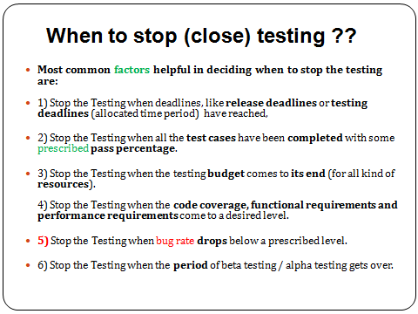

Slide 100
Test Planning
One master test plan should be produced for the overall testing effort
  purpose is to provide an overview of the entire testing effort
  It should identify the test units, features to be tested, approach for testing, test deliverables, schedule, personnel allocation, the overall training needs and the risks
One or more detailed test plans should be produced for each activity - (unit testing, integration testing, system testing, acceptance testing)
  purpose to describe in detail how that testing activity will be performed

Slide 101
SW Test Documentation
Test Plan
Test design specification
Test cases specification
Test procedure specification
Test incident reports, test logs
Test summary report

Slide 102
SW Test Documentation
Test design specification
    to specify refinements of the test approach and to identify the features to be covered by the design and its associated tests. It also identifies the test cases and test procedures, if any, required to accomplish the testing and specifies the feature pass/fail criteria
Test cases specification
    to define a test case identified by a test design specification. The test case spec documents the actual values used for the input along with the anticipated outputs. It identifies any constraints on the test procedures resulting from use of that specific test case.
    Test cases are separated from test designs to allow for use in more than one design and to allow for reuse in other situations.

Slide 103
SW Test Documentation
Test procedure specification
    to identify all steps required to operate the system and execute the specified test cases in order to implement the associated test design.
    The procedures are separated from test design specifications as they are indented to be followed step by step and should not have extraneous detail.

Slide 104
SW Test Documentation
Test Log
    to provide a chronological record of relevant details about the execution of tests.
Test incident report
    to document any test execution event which requires further investigation
Test summary report
    to summarize the results of the testing activities associated with one or more test design specs and to provide evaluations based on these results

Slide 105
SW Testing Tools
Capture/playback tools
  capture user operations including keystrokes, mouse activity, and display output
  these captured tests form a baseline for future testing of product changes
  the tool can automatically play back previously captured tests whenever needed and validate the results by comparing them to the previously saved baseline
  this makes regression testing easier
Coverage analyzers
  tell us which parts of the product under test have been executed (covered) by the current tests
  identifies parts not covered
  varieties of coverage - statement, decision, … etc.

Slide 106
SW Testing Tools
Memory testing (bounds-checkers)
  detect memory problems, exceeding array bounds, memory allocated but not freed, reading and using uninitialized memory
Test case management
  provide a user interface for managing tests
  organize tests for ease of use and maintenance
  start and manage test execution sessions that run user-selected tests
  provide seamless integration with capture/palyback and coverage analysis tools
  provide automated test reporting and documentation
Tools for performance testing of client/server applications

Slide 107
SW Testing Support Tools
Defect tracking tools
  used to record, track, and generally assist with the management of defects
  submit and update defect reports
  generate pre-defined or user-defined management reports
  selectively notify users automatically of changes in defect status
  provide secured access to all data via user-defined queries

